Slide 1

The Jobissimo Project
navigation through
job listings
occupations
courses
Jessica Allan
Leslie Joe
Sergey Gurvich
Notes:
the suffix '-issimo' means 'exceptional' or 'remarkable'
Jess

Slide 2
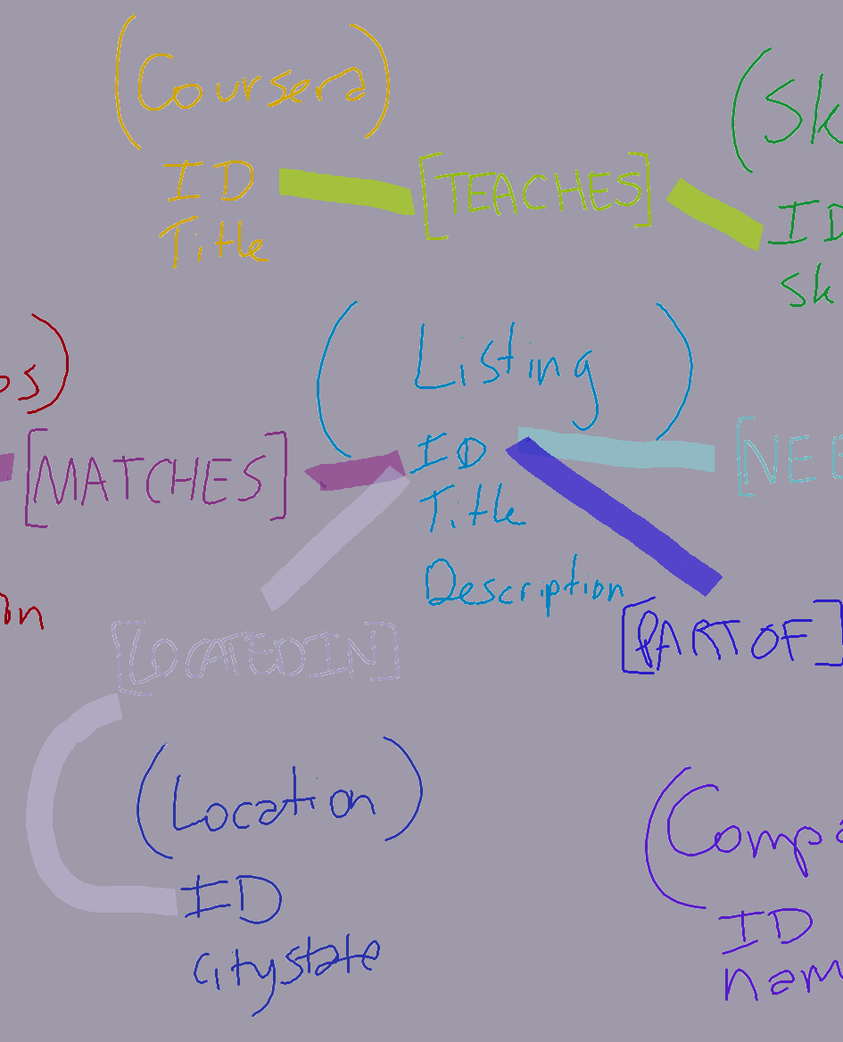
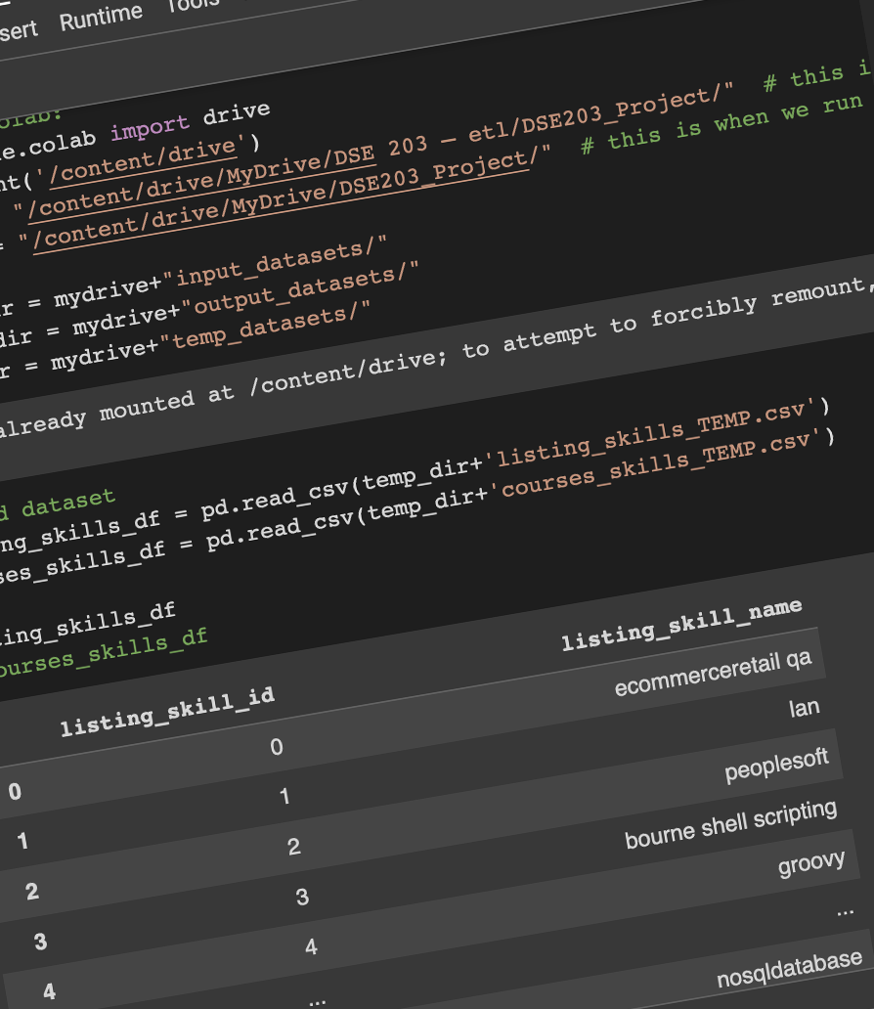
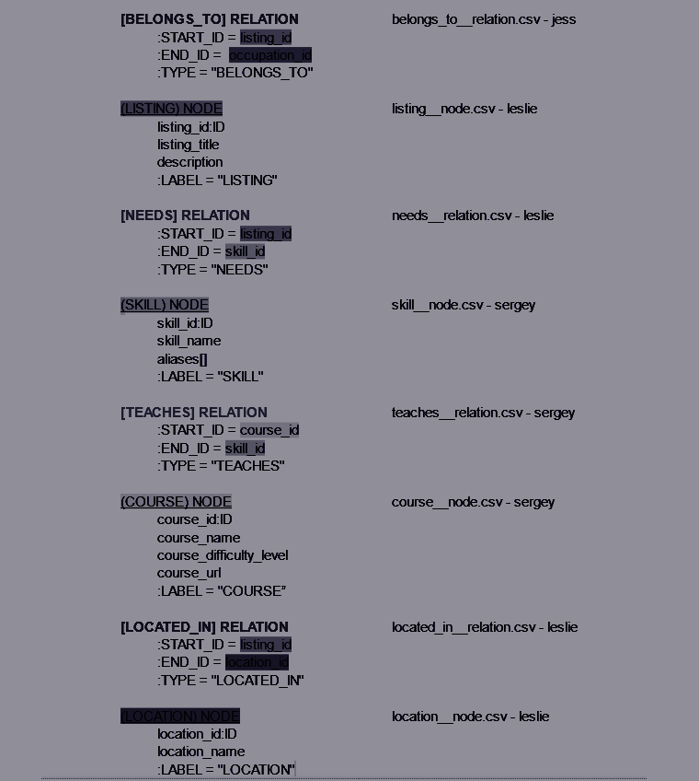
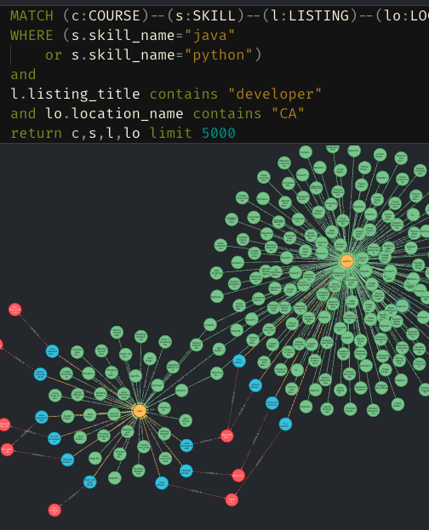
Problem Statement
The average person spends 900,000 hours at work over the course of their life-time, so it stands to reason that changing career paths should be taken seriously. The skill set a person has is integral to advancing through the working world, so we set out to connect current occupations to job listings to the Coursera courses that will give you the skills to land your dream job.
Notes:
Jess

Slide 3

What is our knowledge graph supposed to accomplish?
Correctly connect job listings to occupations
Find more information about the job on the listing
Avg Salary
Career Outlook
Correctly establish a relationship between what skills are needed for a job listing and what skills are taught through courses on Coursera
Which courses would best teach the majority of needed skills for a job posting
Holistic view of jobs and skills
Notes:
Jess

Slide 4
Dataset One: Job Listings Dataset
Dataset was of 22,000 job listings in the US from dice.com as provided by PromptCloud on Kaggle.
We kept the following data
Job Titles
Job Descriptions
Job’s Company
Job’s Location
Job’s list of needed skills
Notes:
The skill sets were the most important, and unfortunately also the least clean. The raw `skills` column was fraught with useless records, such as plain-english references to the job description (like “See job description” and “please refer to job overview”) and plain-english descriptions of skills rather than a pure list (like “Our company is looking for people who have strong Python skills” or even more useless “this job is full time”). So we cleaned both the skills and descriptions columns up by getting rid of useless characters and filtering out skills like “see job description.” And then we used NLP’s spacy and stanza to extract ORG and PRODUCT entities on sentences within the `skills` column (where we qualified “sentences” as strings with 5 or more whitespace tokens, unbroken up by commas) and then again on the descriptions.
https://www.kaggle.com/datasets/PromptCloudHQ/us-technology-jobs-on-dicecom
Leslie

Slide 5
Dataset Two: Occupations
Dataset was obtained from ONET, an online database that contains all occupations in the United States.
We kept the following data
Occupation Title
Occupation Synonyms
Occupation Description
Expected Career Outlook
Occupation Salary
Notes:
general occupation types like “software eng.”
https://www.onetonline.org/
Leslie

Slide 6
Dataset Three: Coursera Courses
Dataset was of 3,500 online classes offered by coursera.org as provided by Khushee Kapoor on Kaggle.
We kept the following data
Course Names
Course Description
Course Difficulty Levels
Course URLs
Course’s list of taught skills
Notes:
https://www.kaggle.com/datasets/khusheekapoor/coursera-courses-dataset-2021
Leslie

Slide 7
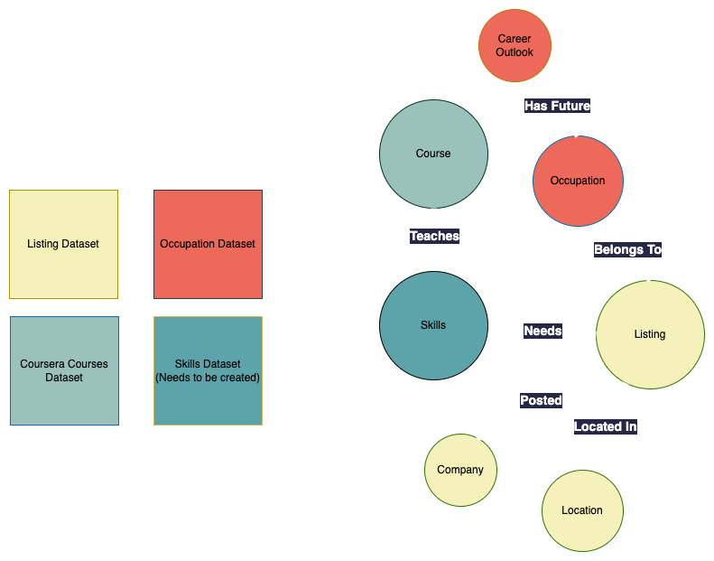
Our Plan: Graph Model
Notes:
High overview of what’s happening
expanded datasets into different types of nodes
Ideally want to extract skills from the listing dataset and the coursesera datasets
Talk about plan of how to make this skills node
Leslie

Slide 8

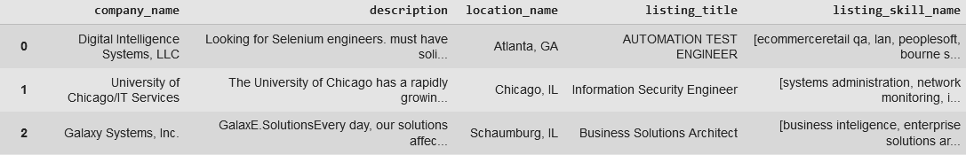
Cleaning: Job Listing Dataset
SKILLS:
Removed special characters except for + and # for C++ and C##
Kept stopwords and lower/uppercase for Spacy and Stanza
Some “skills” were filled out as things like “read job description” and “see below” (not case sensitive)
Removed those skills
Some “skills” were duplicates of the job description or full sentences (like “this job requires Python and Java knowledge”)
Extracted most ORG and PRODUCT entities with Spacy and Stanza
DESCRIPTION
Removed special characters
Kept stopwords and lower/uppercase for Spacy and Stanza
For jobs with empty skill lists, we extracted most ORG and PRODUCT entities from the description
Notes:
leslie
SKILLS:
took out misc. strings like “...” and double spaces but left in + and # for C++ and C##
did not remove stopwords for Spacy and Stanza
removed ““skills”” that were filled out as things like “read job description” and “see below” (not case sensitive) so the skills were now blank (rather than deleting the row)
done with str.replace and str.contains; we’ll want to use jaccard/lev/cos distances in the future
removed ““skills”” that were duplicates of the job description
searched sentences (like “this job requires Python and Java knowledge”) that were incorrectly saved in the skills column, extracted most ORG and PRODUCT entities with Spacy and Stanza, and deleted the sentences (where “sentence” was defined in our code as strings with 6 or more whitespace tokens)
DESCRIPTION
removed special characters (but not stopwords for Spacy and Stanza again)
extracted most ORG and PRODUCT entities from description when skill lists were empty, and populated the skill list with those entities

Slide 9
Cleaning: Coursera Dataset
Needed to clean any special and foreign language characters from Course Name, Course Description and original Skills columns
The original Skills columns was in the format: “Skill_1 Skill_2 Skill_3”. Converted this column to be as type ‘list’ to be able to append the skills extracted from other columns (next step).
Notes:
leslie

Slide 10
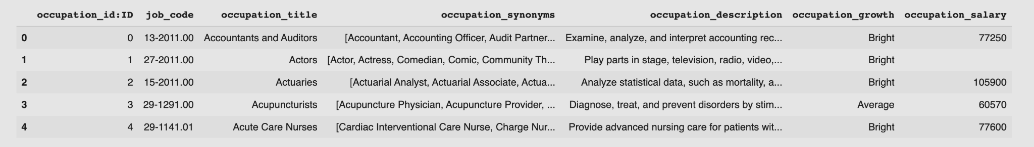
Cleaning: Occupation Dataset
Had to request the data from the ONET API and parse the XML response
First API call was to get the list of all occupations
Second API call was to get expected career outlook for each occupation
Third API call was to get the expected salary for each occupation
The occupation synonyms column was split into an array of synonyms rather than a long string by replacing the word ‘and’ with a comma, and then splitting the string on commas
['Business Intelligence Analyst', 'Competitive Intelligence Analyst', 'Data Analyst', 'Intelligence Analyst', 'Market Intelligence Analyst', 'Market Intelligence Consultant', 'Strategic Business and Technology Intelligence Consultant', 'Strategist']
Besides missing data, the returned data was pretty clean
Notes:
“synonyms” were split into lists just like we did for the “skills” columns in the other two datasets
leslie

Slide 11
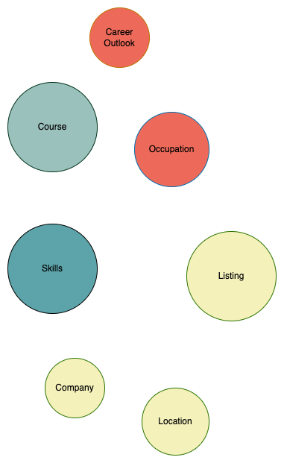
Creating Nodes
Nodes were created out of the cleaned datasets
Our Jupyter Notebooks were shared in a google drive using Colab
The notebooks create an individual CSV for each node type
Stored into the “Output Dataset” folder
We followed a predetermined schema to keep names consistent
(NAME OF NODE) NODE
node_id:ID
node_title
attribute_1
atrribute_2
:LABEL = "NAME OF NODE"
Notes:
Jess

Slide 12
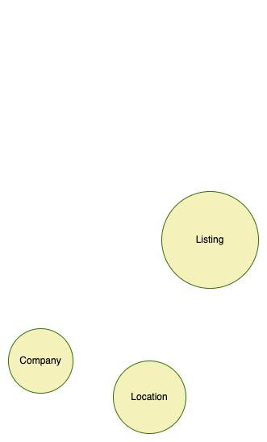
Creating Nodes: Listing, Location & Company
From the Listings dataset
Created the LISTING nodes out of the job’s titles and descriptions as the only properties
Created the COMPANY nodes out of just the company names
Created the LOCATION node out of just the location name, as saved in the original Kaggle dataset as “City, State_Abbreviation”
The original Skills column was not included, as it would be used to create SKILLS node (further step)
(LISTING) NODE
listing_id:ID
listing_title
description
:LABEL = "LISTING"
(COMPANY) NODE
company_id:ID
company_name
:LABEL = "COMPANY”
(LOCATION) NODE
location_id:ID
location_name
:LABEL = "LOCATION"
Notes:
Jess

Slide 13
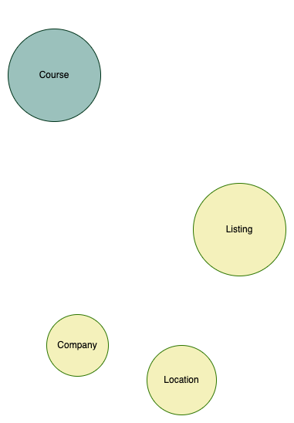
Creating Nodes: Course
From the Courses dataset
Created the COURSE node that will have Course Name, Difficulty Level and Course URL as the node properties
The original Skills column was not included, as it would be used to create SKILLS node (further step)
(COURSE) NODE
course_id:ID
course_name
course_difficulty_level
course_url
:LABEL = "COURSE"
Notes:
Jess

Slide 14
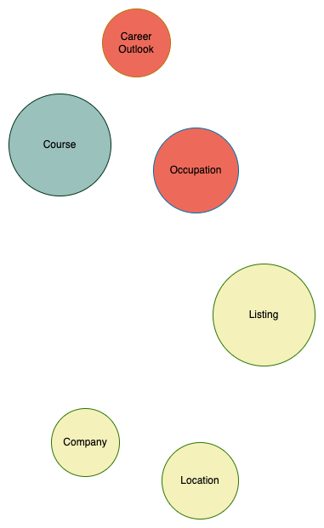
Creating Nodes: Occupation & Career Outlook
From the Occupation dataset
Created the career outlook node by finding unique career outlooks and giving them an ID
Remaining columns were kept as attributes for the Occupation Node
(OCCUPATION) NODE
occupation_id:ID
occupation_title
onet_code
occupation_synonyms
occupation_description
occupation_salary
:LABEL = "OCCUPATION"
(CAREER_OUTLOOK) NODE-
career_outlook_id:ID
career_outlook
:LABEL = "CAREER_OUTLOOK"
Notes:
Jess

Slide 15
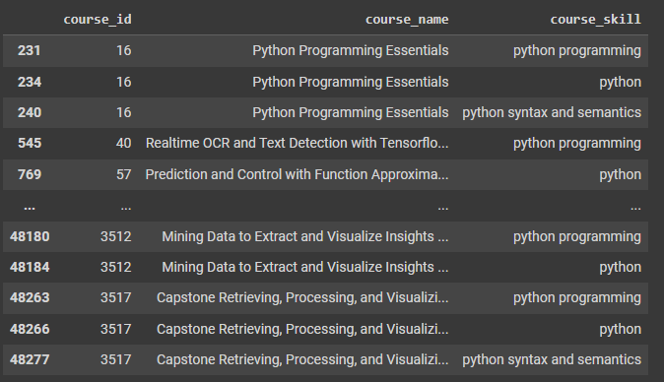
Creating Nodes: Skills
Extracting Course Skills for further matching with Listing Skills:
Step 1: Extracted skills from Course Description using SPACY and STANZA together: ORG and PRODUCT: entities
Step 2: Extracted skills from Course Title using SPACY and STANZA together: ORG and PRODUCT entities
Step 3: Appended results of Step 1 and Step 2 to the list of originally provided Skills and removed duplicates
Step 4: ‘Exploded’ the updated Skills column to have rows Course : Skill (one skill per row)
Notes:
sergey

Slide 16
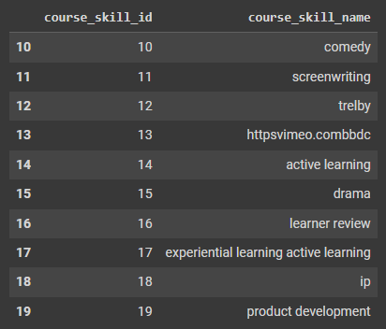
Creating Nodes: Skills
Extracting Course Skills for further matching with Listing Skills:
Step 5: Removed duplicated skills (lower-cased)
Step 6: Save into ‘intermediate’ table ‘Course Skills’ for further matching
Notes:
sergey

Slide 17
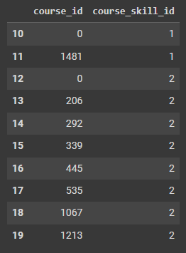
Creating Nodes: Skills
Extracting Course Skills for further matching with Listing Skills:
Step 7: Created ‘intermediate’ table to map Courses Skills to Courses that they were extracted from:
Now Course Skills is ready for matching with Listing Skills
Notes:
sergey

Slide 18
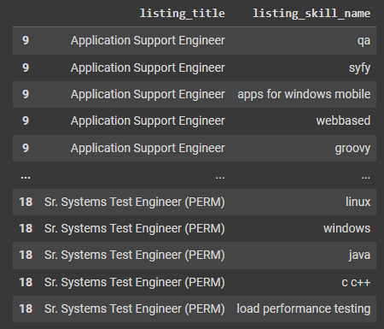
Creating Nodes: Skills
Extracting Listing Skills for further matching with Course Skills:
Step 1: If the original Skills column contained sentences instead list of skills, extracted skills from these sentences using SPACY and STANZA together: ORG and PRODUCT: entities
Step 2: If after Step 1, we still didn’t have any valid skills in the Skills column, applied skills extraction from Listing Description using SPACY and STANZA together: ORG and PRODUCT entities
Step 3: Now we have a complete list of skills for each Listing, remove duplicates from each list
Step 4: ‘Exploded’ the updated Skills column to have rows Listing : Skill (one skill per row)
Notes:
sergey

Slide 19
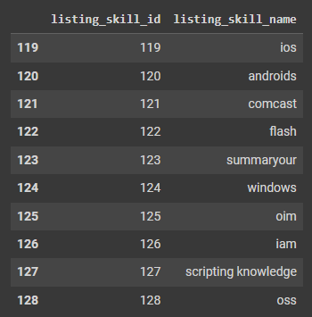
Creating Nodes: Skills
Extracting Listing Skills for further matching with Course Skills:
Step 5: Removed duplicated skills (lower-cased)
Step 6: Save into ‘intermediate’ table ‘Listing Skills’ for further matching
Now Listing Skills is ready to meld with Course Skills
Notes:
sergey

Slide 20
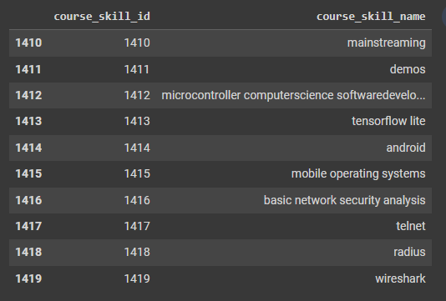
Creating Nodes: Skills
Matching Listing Skills with Course Skills:
Step 1: Matching Listing Skills to Course Skills using 3-Gram Tokenizer and Jaccard Similarity Measure with Threshold=0.6 (pruning was applied for performance, because skills names lengths vary a lot):
Notes:
sergey

Slide 21
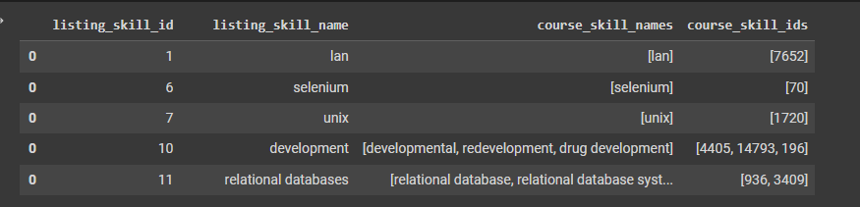
Creating Nodes: Skills
Matching Listing Skills with Course Skills:
Step 2: After matching, we want to preserve all matched Course Skills, so we make a list of matched skills as an attribute and include all ‘aliases’ there.
Notes:
sergey

Slide 22
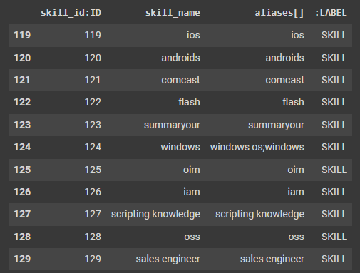
Creating Nodes: Skills
Matching Listing Skills with Course Skills:
Step 3: Create SKILL node table:
(SKILL) NODE
skill_id:ID
skill_name
aliases[]
:LABEL = "SKILL"
Notes:
sergey

Slide 23
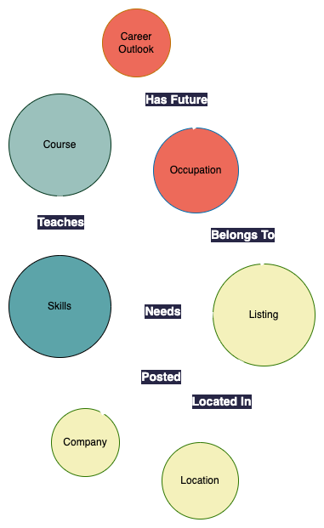
Creating Relations
The notebooks create an individual CSV for each relation type
Also stored into the “Output Dataset” folder
We followed a predetermined schema to keep names consistent
(NAME OF RELATION) RELATION
:START_ID = start_node_id
:END_ID = end_node_id
:TYPE = "NAME_OF_RELATION"
Notes:
Jess

Slide 24
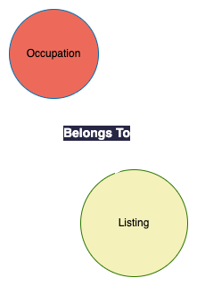
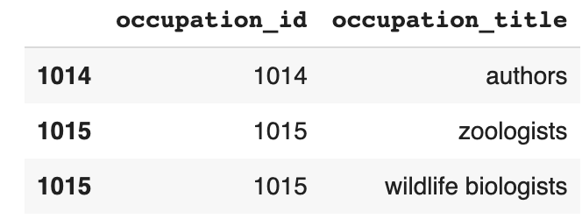
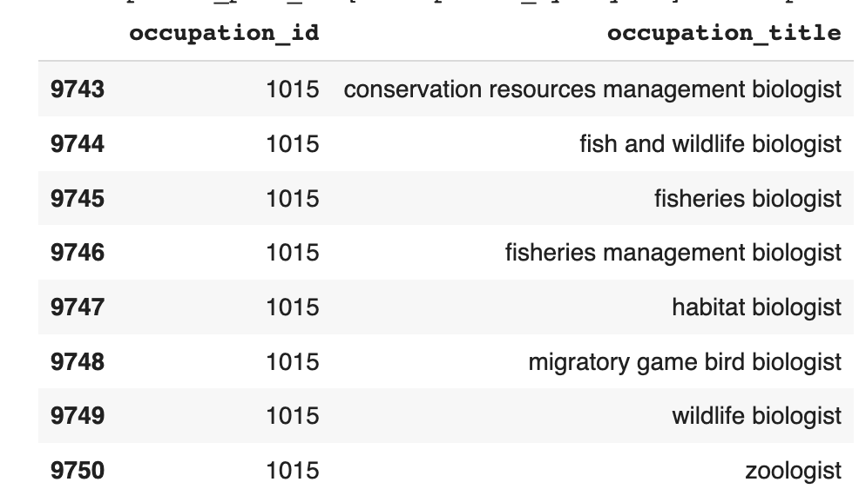
Creating relation: Belongs To
Steps to match Listing Title and Occupation
Turn everything lowercase and remove certain characters (leave in +)
Occupation Title often had two titles in one
“Zoologist and Wildlife Biologists”
Split into two rows, “Zoologist” and “Wildlife Biologists” with same ID
Explode the occupation_synonym array and have the synonyms also represent occupation titles and appended the results
Notes:
Jess

Slide 25
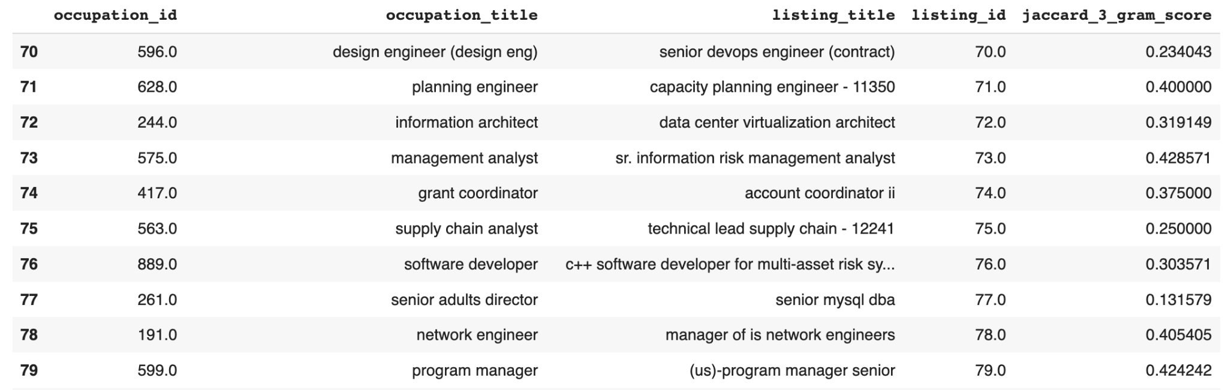
Creating relation: Belongs To
For every listing title, loop through every occupation title to find the highest 3-gram Jaccard similarity score
Helped account for miss-spellings or slight changes such as Software Engineer 3 vs Software Engineer
White space and other n-grams were not as successful
relatively short titles
Notes:
Jess

Slide 26
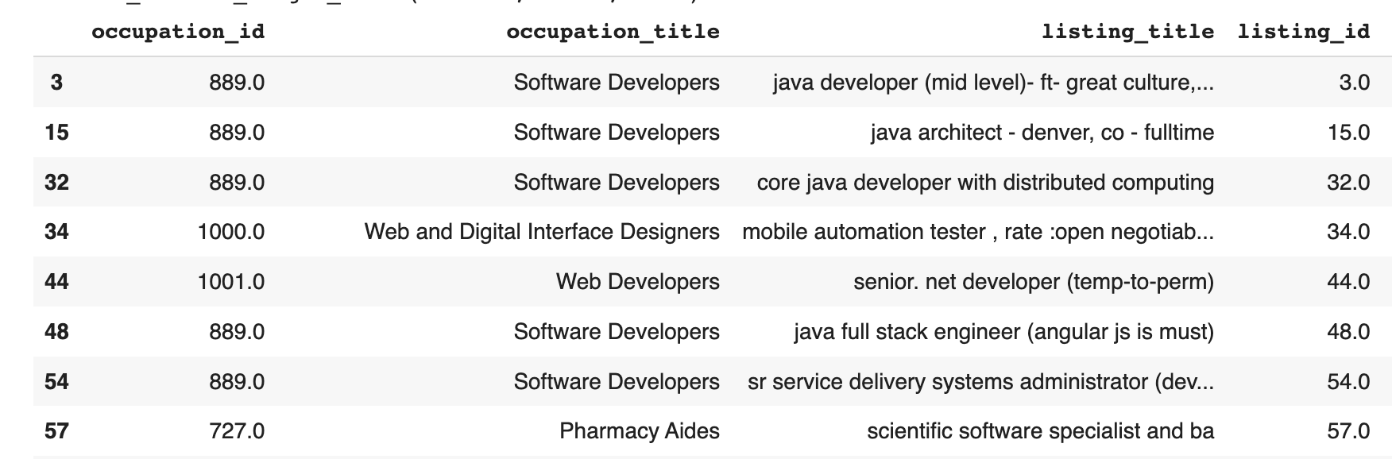
Creating relation: Belongs To
If the highest similarity score for the listing title was < 0.3, then the cleaned listing skills were used to generate a request from the ONET API to find the most similar occupation match
Appended the two dataframes together
(BELONGS TO) RELATION
:START_ID = listing_id
:END_ID = occupation_id
:TYPE = "BELONGS_TO"
Notes:
Jess

Slide 27
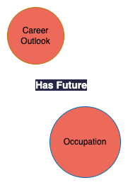
Creating Relation: Has Future
(HAS_FUTURE) RELATION
:START_ID = occupation_id
:END_ID = career_outlook_id
:TYPE = "HAS_FUTURE"
Notes:
jess

Slide 28
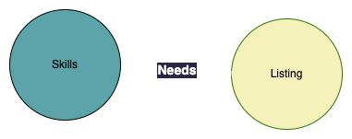
Creating Relation: Needs
(NEEDS) RELATION
:START_ID = listing_id
:END_ID = skills_id
:TYPE = "NEEDS"
Notes:
jess
after having our skills node, we had connection between skills and listing/courses, so we created relationship table

Slide 29
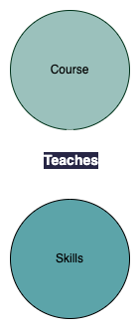
Creating Relation: Teaches
(TEACHES) RELATION
:START_ID = course_id
:END_ID = skills_id
:TYPE = "TEACHES"
Notes:
jess

Slide 30
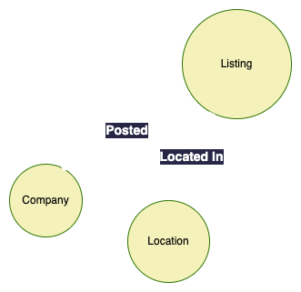
Creating Relation: Located In & Posted
(LOCATED_IN) RELATION
:START_ID = listing_id
:END_ID = location_id
:TYPE = "LOCATED_IN"
(HAS_FUTURE) RELATION
:START_ID = company_id
:END_ID = listing_id
:TYPE = "HAS_FUTURE"
Notes:
jess
go super fast because these are super simple

Slide 31
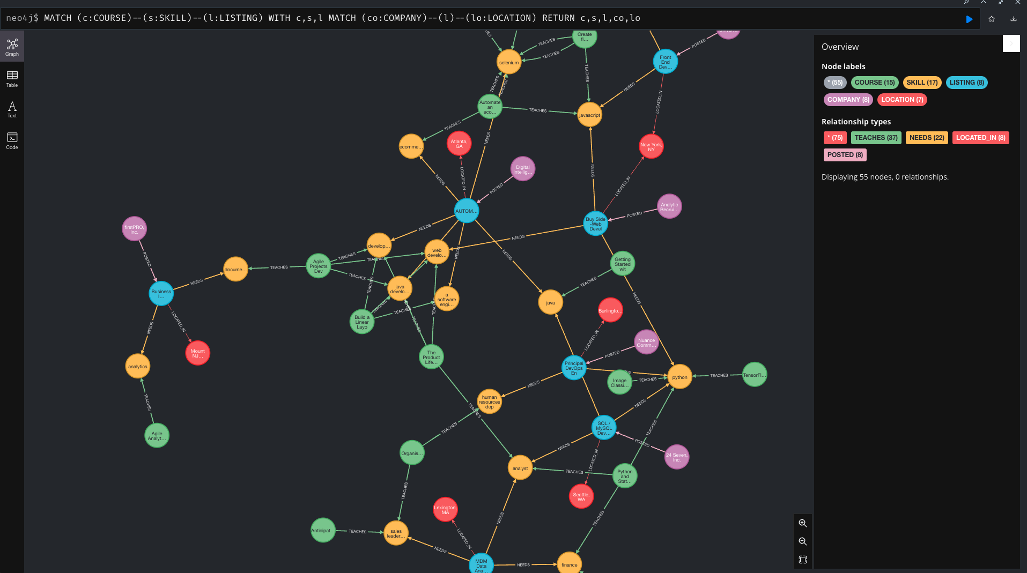
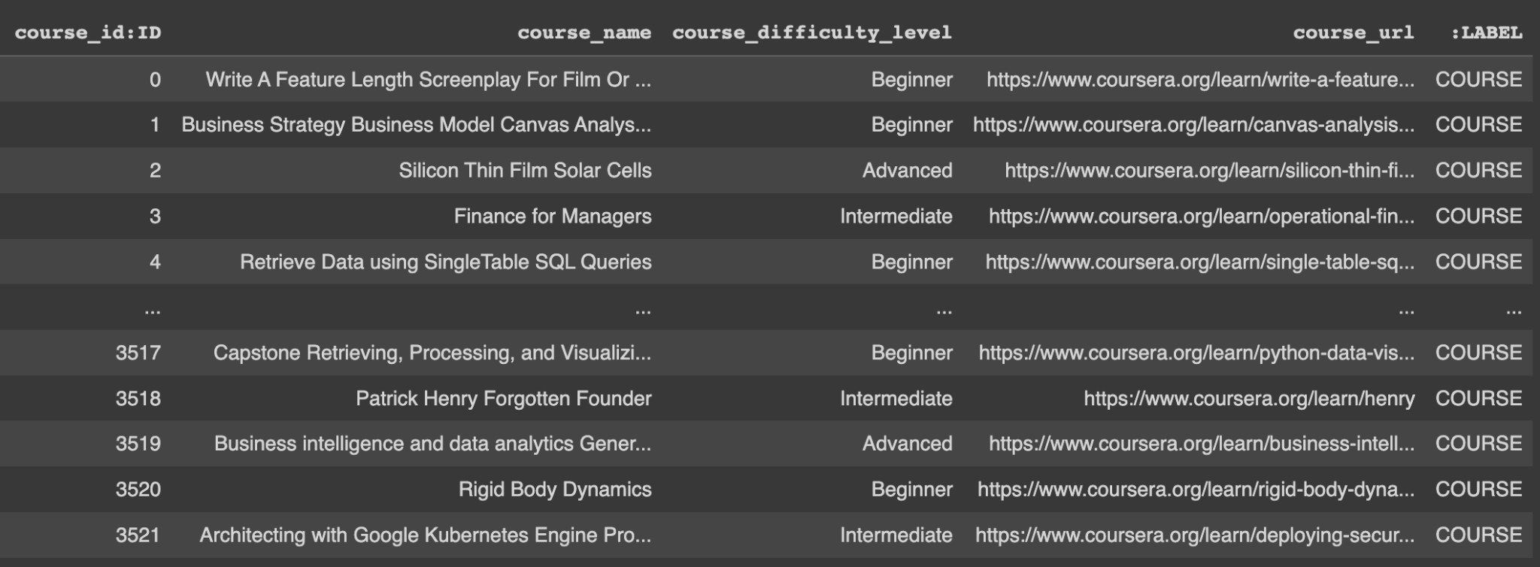
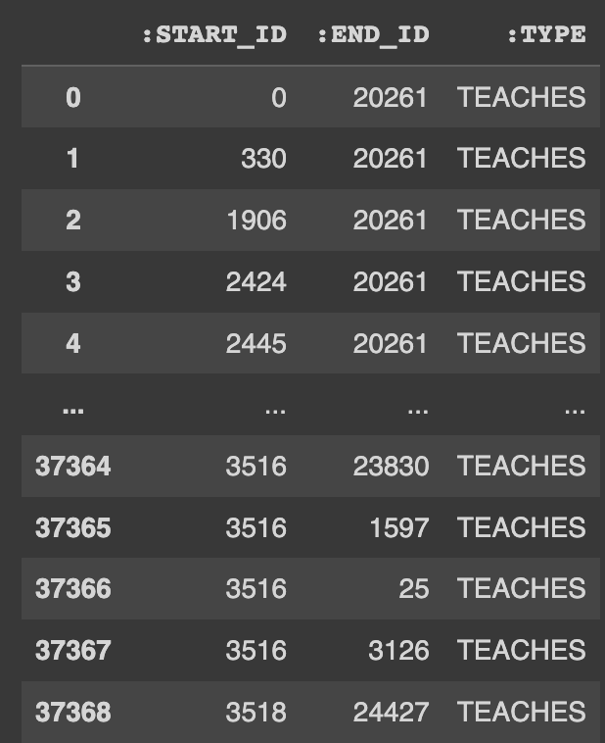
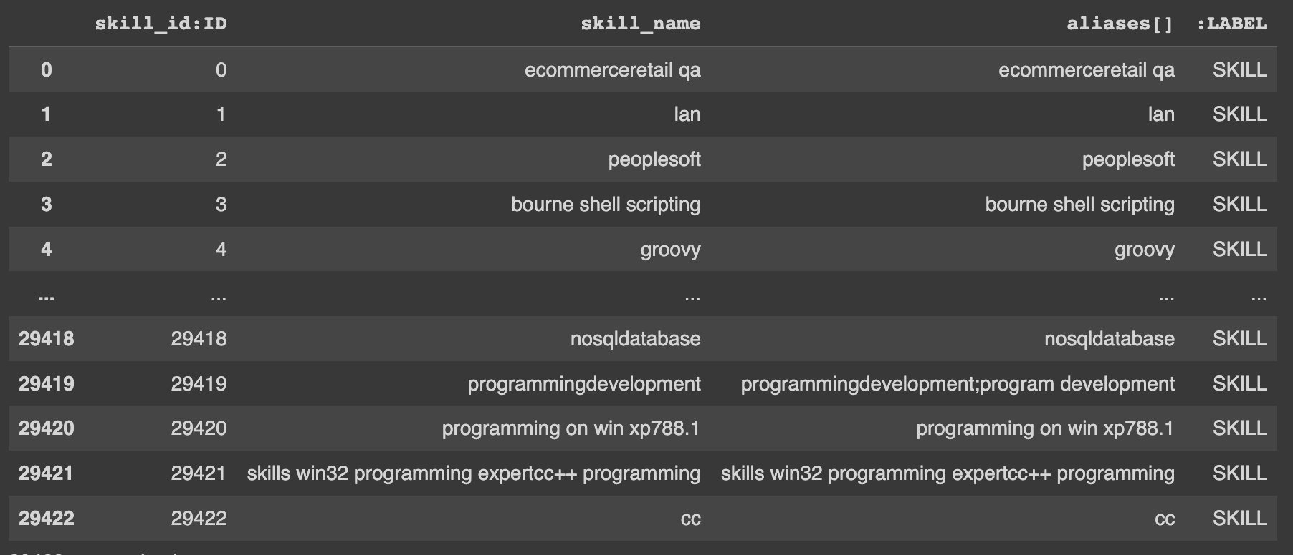
Export to Neo4j
Take all the saved Nodes and Relationship tables
Increment :IDs of each table such that nodes’ IDs never repeat
Export to the DB using neo4j-admin command
55453 nodes, 206814 relationships, 167584 properties
Notes:
sergey

Slide 32
Tools Used
Spacy + Stanza for extracting skills entities
PY_stringmatching for skills and job-occupations matching
Python Requests library to download the ONET data
Google Colab to run and share notebooks
AWS RDS Postgres DB
Notes:
sergey

Slide 33
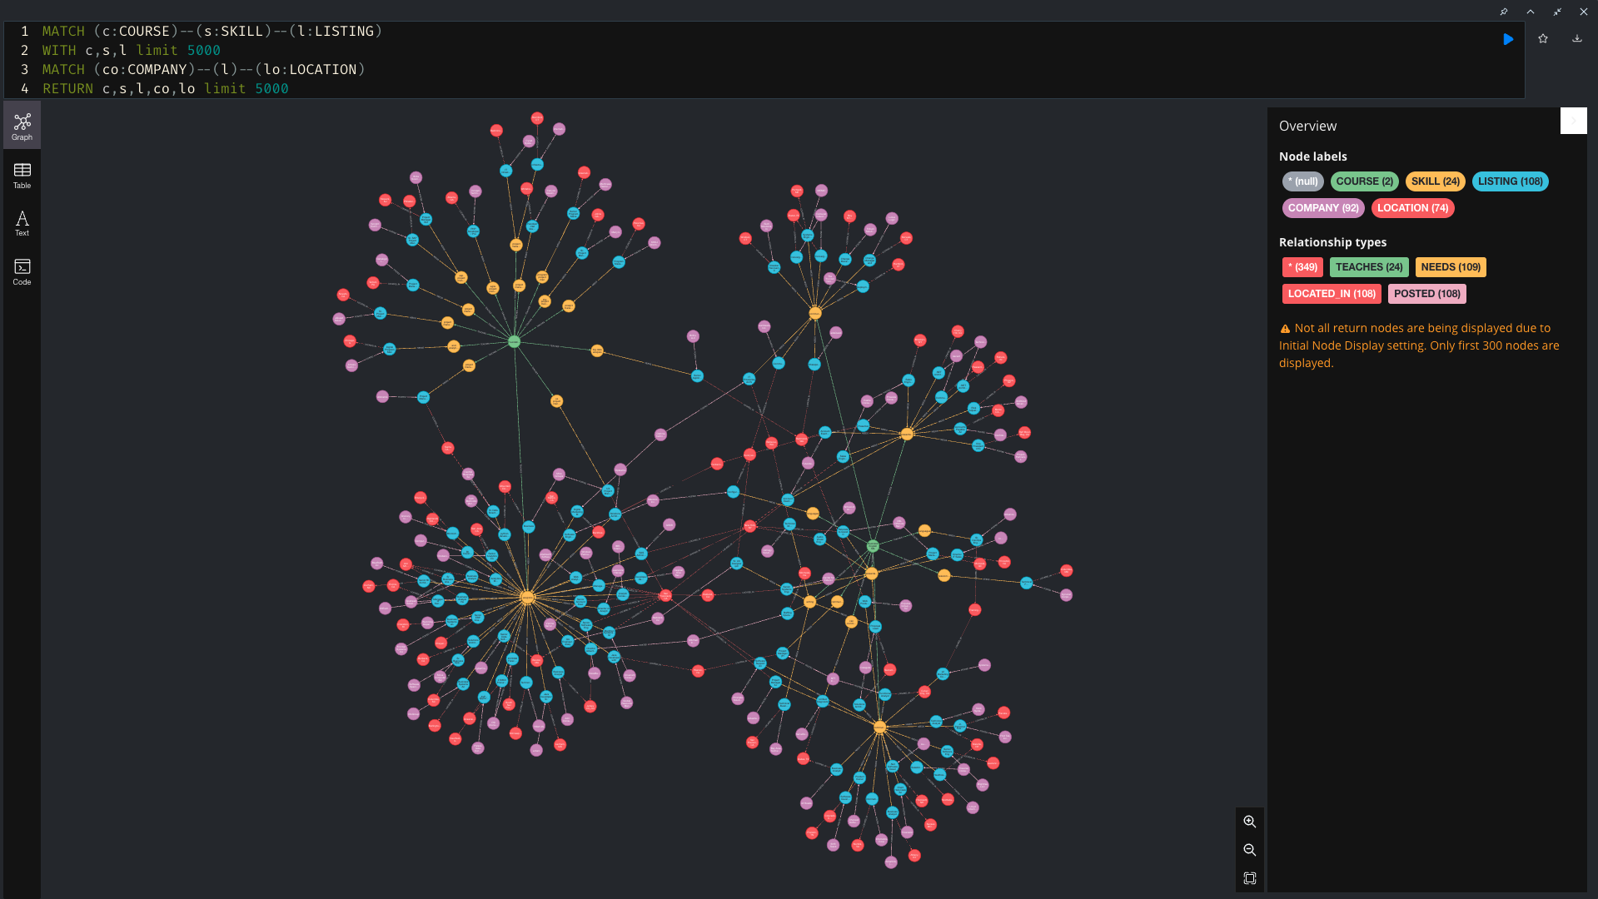
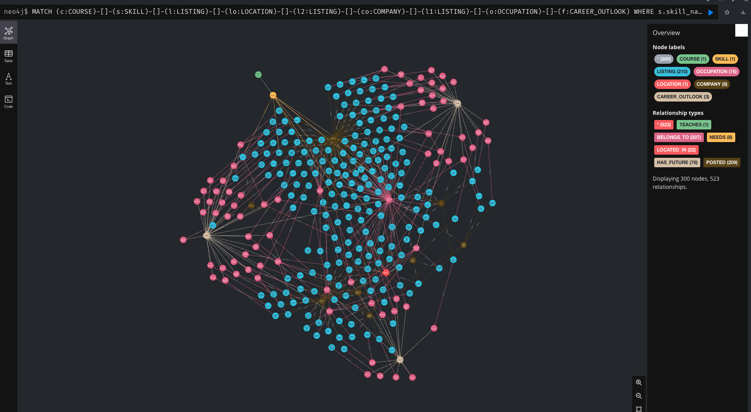
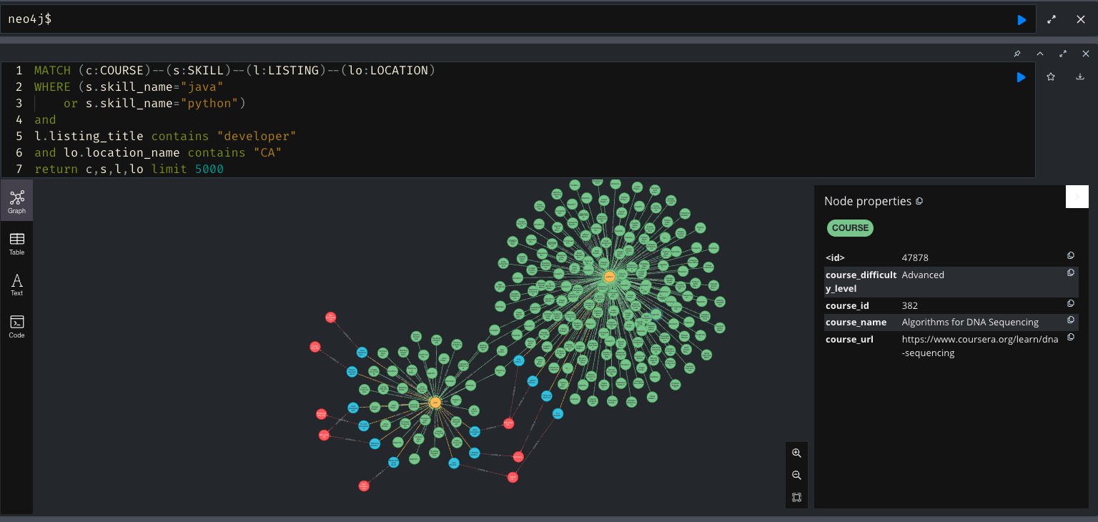
Demo in Neo4j
Notes:
Jess shares screen
goes:
Jess
Sergey
Leslie

Slide 34
Problems and Next Steps
Pruning the skills columns more and more accurate extracting with Stanza and Spacy
Consolidate the skills list (more efficiently combine skills like “quality assurance” and “qa”) by removing the need for the aliases property with PY_stringmatching
Use such metrics as F1 Score and Precision to quantify the string matching quality
Acquire more information about the companies (e.g. working conditions, turnover rate, etc.), and add these as properties to each company node
Create and implement an “APPLICANT” node to represent a person and their skillset, and find results via Neo4j catered to them
Build more complex and sophisticated queries for analytics, especially because the real world application will be constantly updated with new job listings and courses
Notes:
Leslie

Slide 35
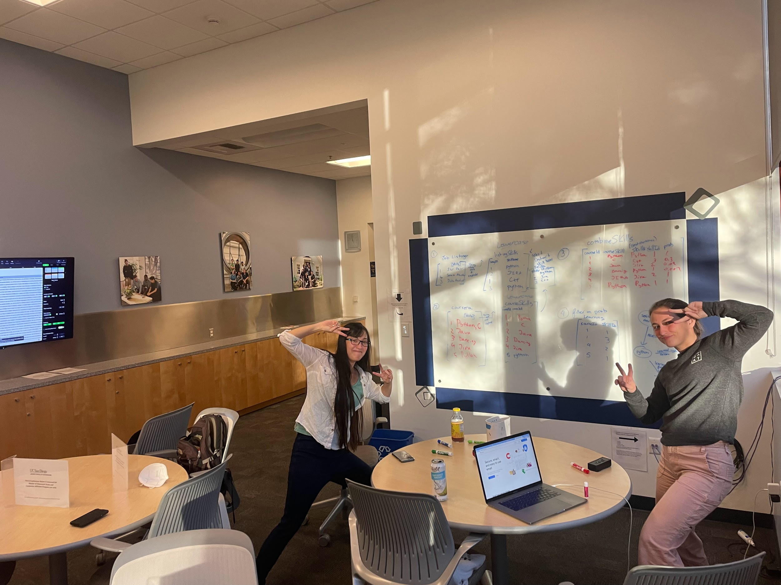

Thank You
Please let us know if you have any questions.
Notes:
Leslie

